Slide 1

Message Transformation
Systems Integration
PBA Softwareudvikling/BSc Software Development
Tine Marbjerg
Fall 2017
Message Transformation

Slide 2
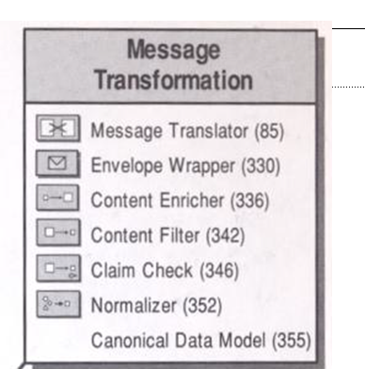

Overview of transformation patterns EIP 8
Message Transformation

Slide 3
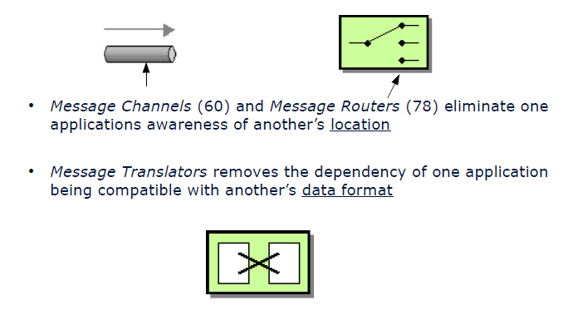
Elimination of Dependencies
Location dependency is one problem:
Data format difference is another problem:
Message Transformation

Slide 4
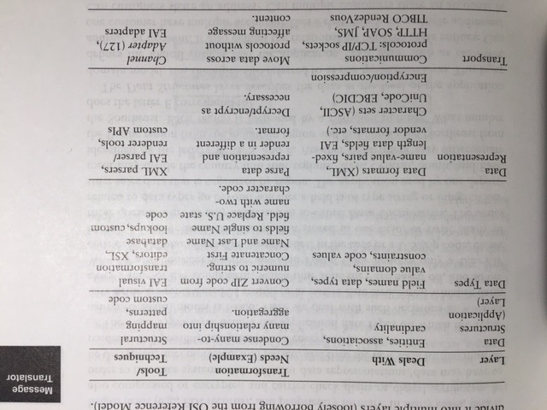
Levels of Transformation
Systems rarely have same data format or data model, so messages must be translated in integration solution

Slide 5
Metadata
Transforming messages requires metadata
Transforming messages is simplified if the Channel Adapters can extract metadata
RabbitMQ Java example of header + body:
QueueingConsumer.Delivery delivery =
consumer.nextDelivery();
String message = new String(delivery.getBody());
delivery.getProperties().getHeaders();
Message Transformation
Notes:
Metadata: Data that describes the format of the actual data

Slide 6
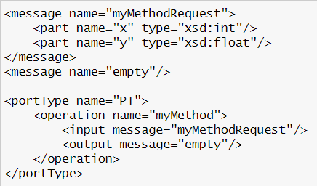
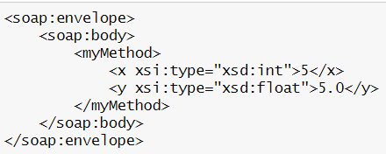
Metadata Format
The metadata can be stored in a variety of formats, e.g. XSD's (XML Schema Definitions) for XML messages
SOAP WSDL EXAMPLE:
RPC/encoded WSDL for MyMethod
RPC/encoded SOAP message for myMethod
Message Transformation
Notes:
encoding, i.e. set of rules of how data types can be packaged and serialized over the net)
Example of SOAP encoding (i.e. set of rules of how data types can be packaged and serialized over the net – this is done at design time)

Slide 7
Transformation illustrated by the SOAP Web Service Idea
<Add>
<x>20</x>
<y>99</y>
</Add>
obj = new WebService();
result = obj.add(20, 99);
(1) XML
Web server
Client
Web
Service
(2) XML
obj
int add(int x, int y)
{ return x + y; }
<Add>
<result>119</result>
</Add>
Message Transformation

Slide 8
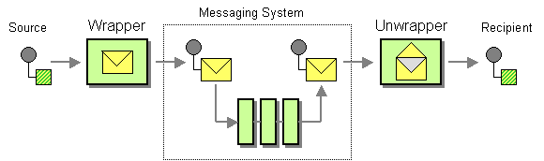
Envelope Wrapper (330)
Envelope Wrapper adds extra data elements to the message header which are necessary for routing, tracking, and handling the message (i.e. unique message id) in the messaging infrastructure
The message source publishes a message in ‘raw’ format
The wrapper transforms this message into a message format compliant with the messaging infrastructure
The messaging system transports the message
A resulting message is delivered to the “unwrapper” that reverses any modifications (e.g. removing header fields or decrypting the message)
The message recipient receives a ‘clear text’ message
Message Transformation
Notes:
unlike content enricher because it does not enrich actual information content, but add information necessary for routing, tracking, and handling message, e.g. verify security credentials

Slide 9



Message Structure
Most messaging systems divide the message data into a header and a body
Header
contains fields that are used by the messaging infrastructure to manage the flow of messages
Body
contains data to be used by the receiving application
Like the Postal System!
Message Transformation
Notes:
DB comparison – JDBC driver – resultSet unwrapping

Slide 10
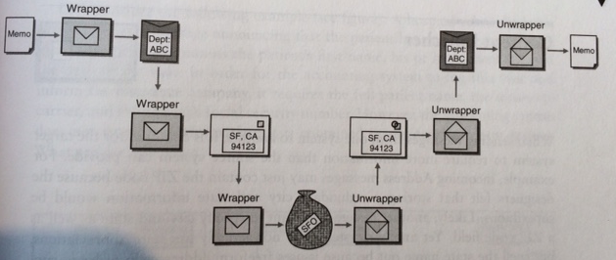
Wrapper chaining: Postal Office Exampe
Illustration of chaining wrappers (pipes and filter messaging architecture):
Source: EIP p. 335
Message Transformation
Notes:
Having wrappers in pipes and filte architeture gives flexibility to add and remove wrapping and unwrapping steps. Fx encryptation might not be required because all traffic is routed across a VPN as oppose to public internet

Slide 11

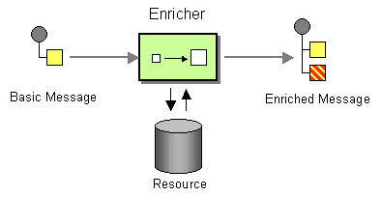
Content Enricher(336)
It is common for the target system to require more information than the source system can provide.
If the message originator does not have all the required data items available, we can use a specialized transformer, a Content Enricher to augment a message with missing information
Message Transformation

Slide 12
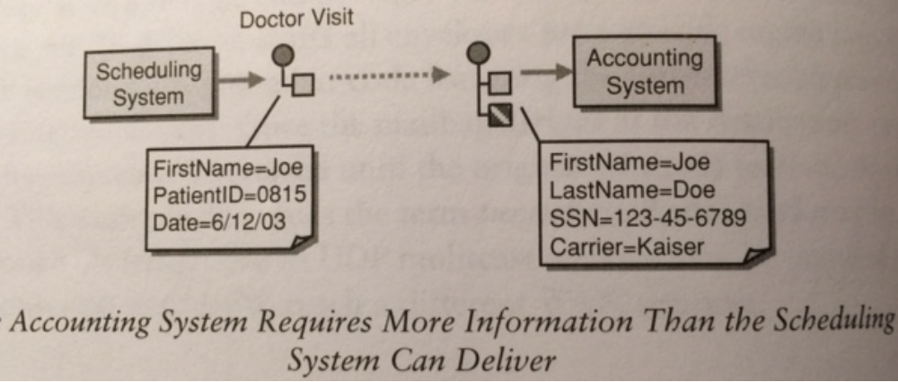
Example of missing data
Source: EIP p. 336
Message Transformation
Notes:
How do we get the required information ?
Environment, e.g. timestamp
external data source /Another system. Retrieves the missing data from another system. Most common one.
Computation

Slide 13
Sources for the new data
Computation. Make computation on the message data
Environment. Retrieve the data from the operating environment (e.g. timestamp)
Another system. Retrieves the missing data from another system. Most common one.
Message Transformation
Notes:
Environment, e.g. timestamp
external data source

Slide 14
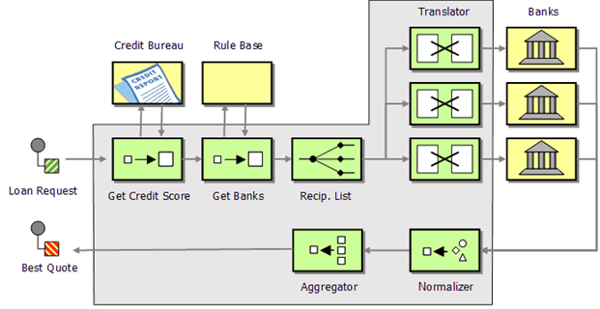
Loan Broker Project
Will you need content enriching?
Message Transformation

Slide 15
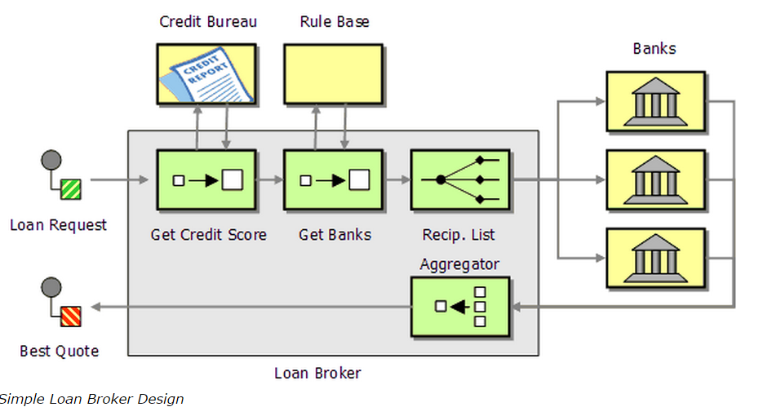
Possible content enricher in your project
Adding customer’s credit score to customer request:
Message Transformation

Slide 16

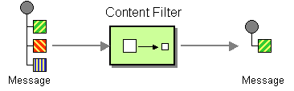
Content Filter (342)
How do you simplify dealing with a large message, when you are interested only in a few data items?
Use a Content Filter to remove unimportant data items from a message leaving only important items
Message Transformation

Slide 17
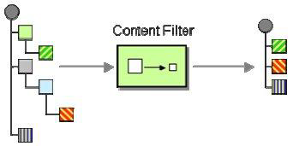
Content Filter variations
Does not necessarily just remove data elements
Useful to simplify the structure of the message
  tree structures
  levels of nested, repeating groups (e.g. normalized db structure)
Message Transformation

Slide 18

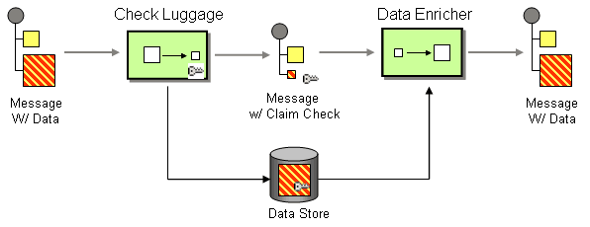
Claim Check (346)
How can we reduce the data volume of a message sent across the system without sacrificing information content?
Store message data in a persistent store and pass a Claim Check to subsequent components. These components can use the Claim Check to retrieve the stored information
Unique key
Message Transformation

Slide 19
Claim Check Steps
A message with data arrives
The Check Luggage component generates a unique key for the information
  How should we choose key?
The Check Luggage component extracts the data from the message and stores it in a persistent store associated with the key
    How long should data be stored?
It removes the persisted data from the message and adds the Claim Check
Another component can use a Content Enricher(336) to retrieve the data based on the Claim Check
Message Transformation

Slide 20

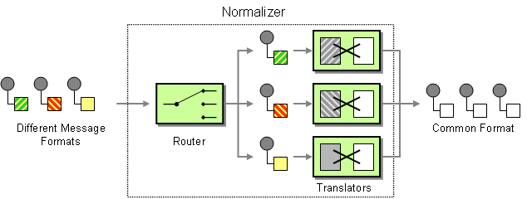
Normalizer (352)
How do you process messages that are semantically equivalent, but arrive in a different format?
Use a Normalizer to route each message type through a custom Message Translator so that the resulting messages match a common format
Data Format Examples
EDI fact
Comma-separated files
XML document
Excel spreadsheet
The router must know the type of incoming message, maybe by a type specifier field in the header
Message Transformation

Slide 21
Detecting the Message Format
Type specifier field in the message header
Name of the root element (e.g. XML documents)
  Xpath expression to detect specific subnodes
Number of fields and type of the data (e.g. comma separated file)
File name (in files ☺)
File folder structure
Message Transformation

Slide 22
Loan Broker Project
Will you need normalization?
Message Transformation

Slide 23
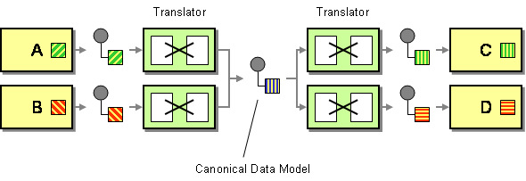
Canonical Data Model (355)
How can you minimize dependencies when integrating applications that use different data formats?
Design a Canonical Data Model that is independent from any specific application. Requires each application to produce and consume messages in this common format
Message Transformation

Slide 24
Doesn’t it Just Get More Complicated?
Direct Message Translators
Transl. Into B format
App A
A data
A data in B format
App B
Canonical Data Model
App A
Transl. A format into Canonical format
Trans. Canonical format into B format
App B
Message Transformation

Slide 25
Performance vs. Maintenance
What happens with an increasing number of systems?
F
A
E
B
D
C
Message Transformation

Slide 26
Performance vs. Maintenance
The number of connections explode!
F
A
E
B
D
C
Message Transformation

Slide 27
Performance vs. Maintenance
    Number of translations without Canonical Data Model*: n * (n – 1), i.e. O(n²)
    * We assume that each application sends and receives messages to and from every other application
F
No. Systems| No. Transl (both ways).
    6
    12
    20
    30
    42
A
E
B
D
C
Message Transformation
Notes:
Big-O analysis is used to measure the efficiency of an algorithm based on the time it takes for the algorithm to run as a function of the input size
N2 - squared
6 systems = 12 translates with canonical model 2 x n
Without canonical model n X n-1

Slide 28
Performance vs. Maintenance
Number of translations with Canonical Data Model:
2 * n, i.e. O(n)
OBS! Can be difficult to design a Canonical Data Model (=enterprise data model)
No. Systems| No. Transl (with canon).
    6
    8
    10
    12
    14
F
A
E
Common format
B
D
C
Message Transformation
Notes:
6 systems = 12 translates with canonical model 2 x n
Without canonical model n X n-1

